Slide 1



Optimizing Quantum Long Short-Term Memory for
Financial Time Series Forecasting
Alex | Florian | Leonard | Mohamad
Final Presentation 08.02.2024

Slide 2
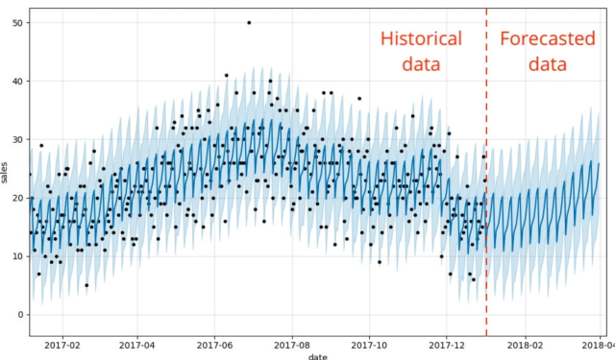
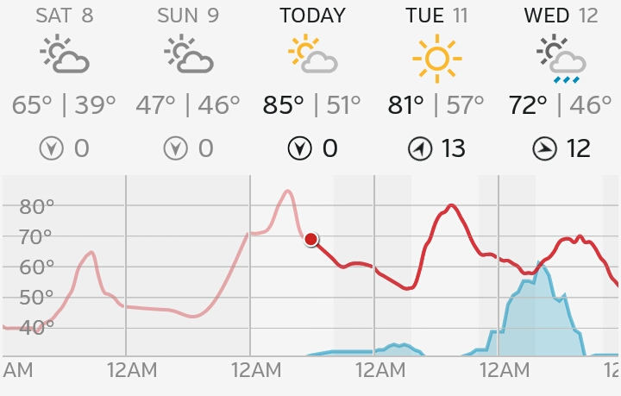
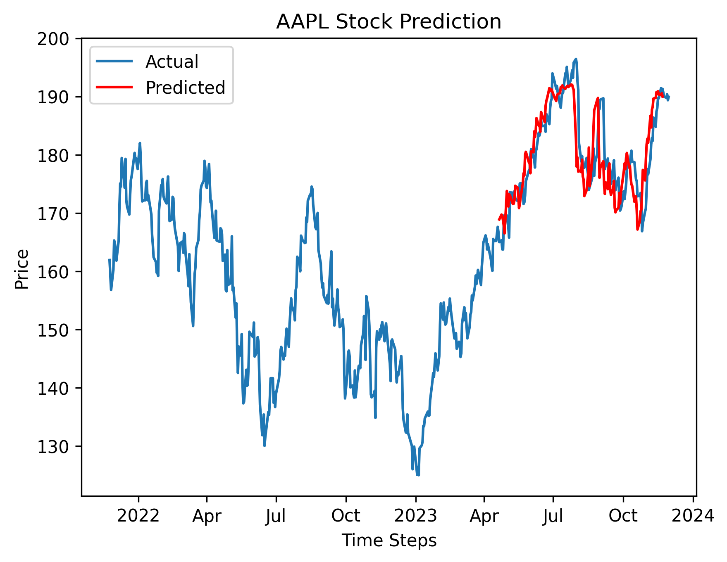
Time Series Forecasting
Sequential Data
Sales Forecasting
Weather Forecasting
Stock Market Prediction
Quantum Machine Learning for Stock Market Prediction

Slide 3


History of Stock Market Prediction
Technical Analysis
Fundamental Analysis
Quantum Neural Networks
1900
1990’s
1101001
0001010
0110100
1011001
17th Century
1934
2024
Quantitative Analysis
Machine Learning and
Artificial Neural Networks
Quantum Machine Learning for Stock Market Prediction

Slide 4
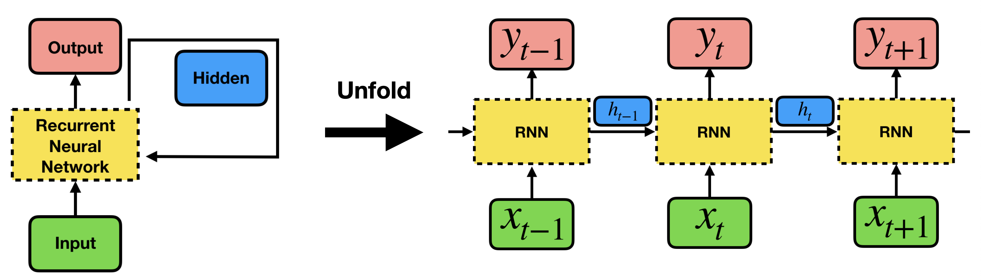
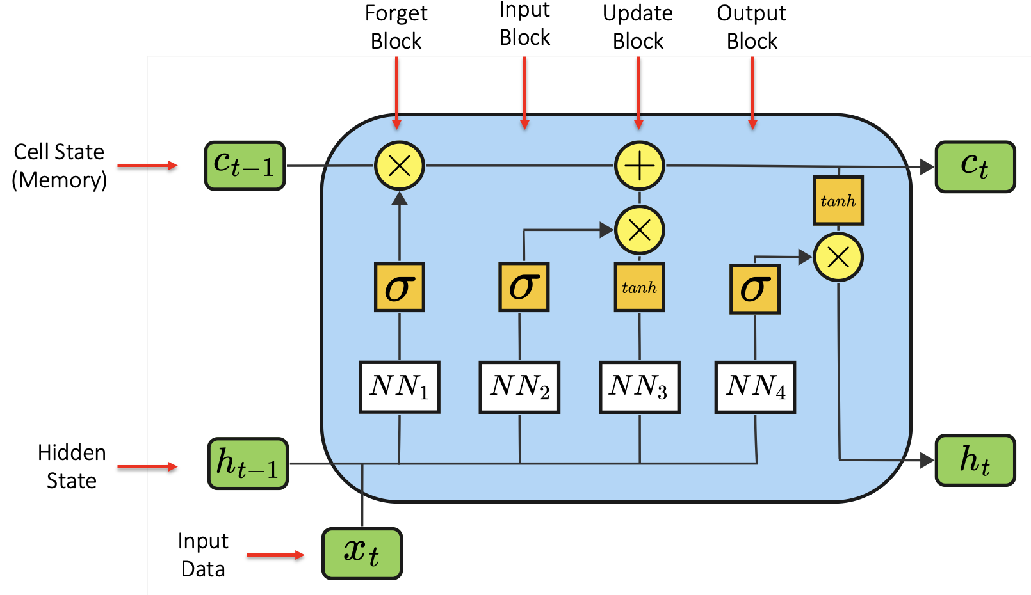
Achieving Our Goal
Quantum Machine Learning for Stock Market Prediction

Slide 5

Stock Data Selection
30 Most Important Stocks
Apple, Amazon, Microsoft,
Nvidia, Alphabet…
Two Years Range: Nov 2021 – Nov 2023
Daily data
Quarterly Data
Financial Market Data
Alpha Vantage API [1]
OHLCV: Prices and Volume
Important Input Features
Daily: Price, Volume, Percentage Change
Quarterly: Revenue, EBIT, Cashflow, Assets, Long-term debts
Using this information to predict the stock market
Quantum Machine Learning for Stock Market Prediction

Slide 6

Related Work
Former Research
Quantum Long Short-Term Memory [2]
Quantum recurrent neural networks for sequential learning [3]
Quantum machine learning in finance: Time series forecasting [4]
The potential of quantum techniques for stock price prediction [5]
Our Work Contributions
Use of multiple input features
Evaluation of different QLSTM architectures
Hyperparameter optimization for QLSTM
Quantum Machine Learning for Stock Market Prediction

Slide 7

Models: Overview
Classical Neural Networks
Quantum Neural Networks
Long Short-Term Memory (LSTM)
Quantum Long Short-Term Memory (QLSTM)
Quantum Recurrent
Neural Network (QRNN)
Quantum Machine Learning for Stock Market Prediction

Slide 8
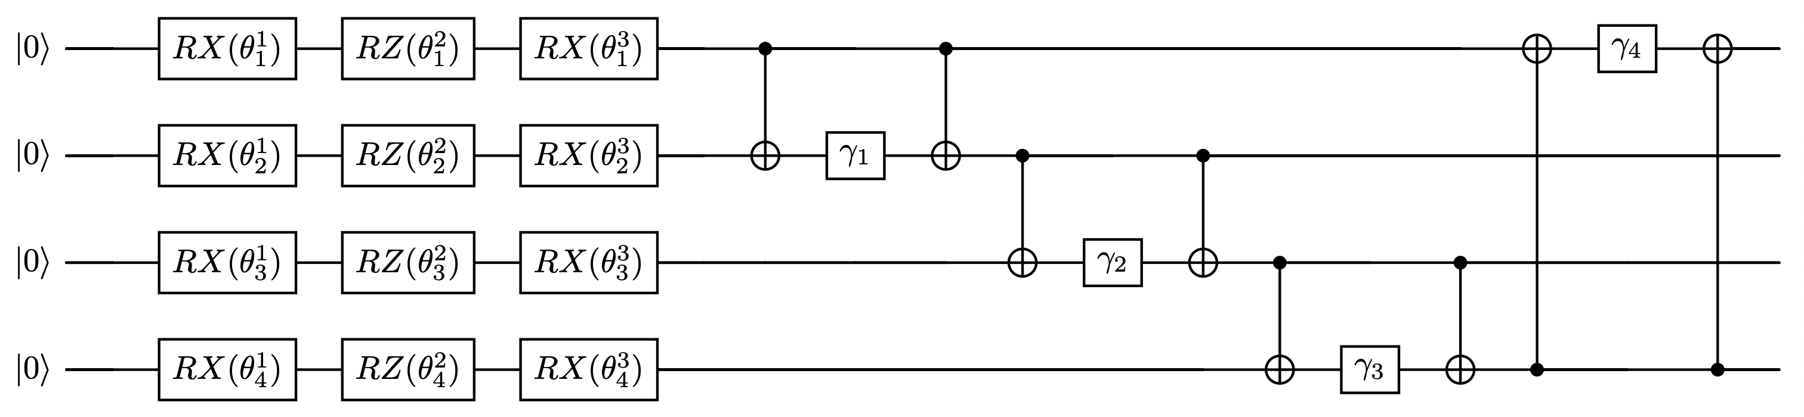
Models: QRNN
Quantum Machine Learning for Stock Market Prediction

Slide 9
Models: QLSTM
Forget Block
Input Block
Update Block
Output Block
Cell State (Memory)
Hidden State
Input Data
Quantum Machine Learning for Stock Market Prediction

Slide 10
Models: QLSTM
Forget Block
Input Block
Update Block
Output Block
Cell State (Memory)
Hidden State
Input Data
Quantum Machine Learning for Stock Market Prediction

Slide 11
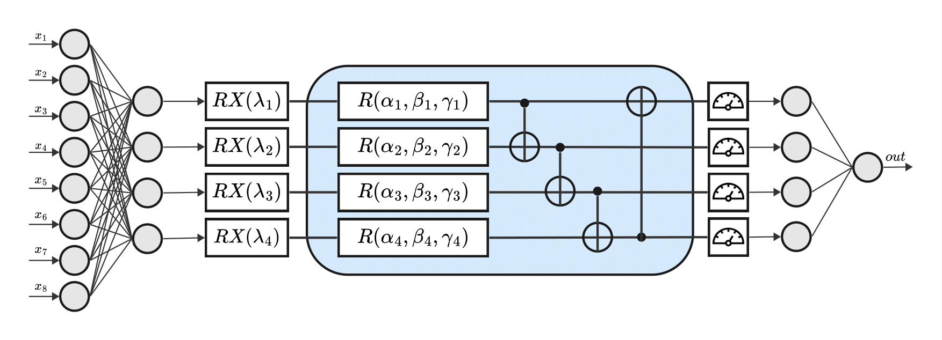
Models: QLSTM VQC
4 Qubits VQC
8 Input Features
Strongly Entangling Layers with 3 variational layers
Quantum Machine Learning for Stock Market Prediction

Slide 12
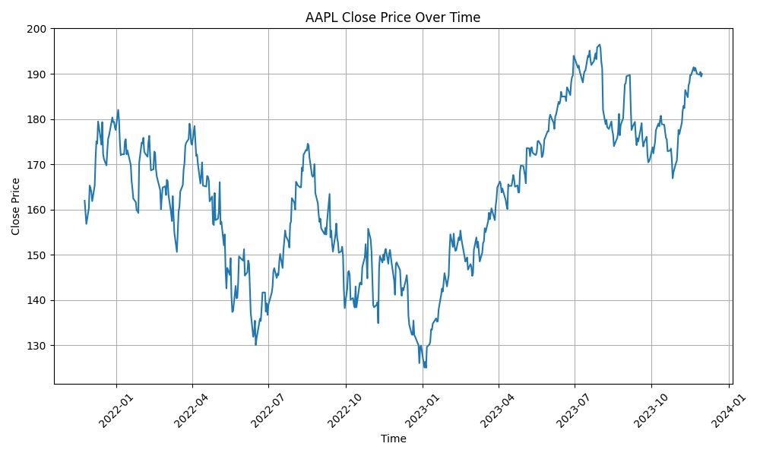





Experimental Setup: Training
Training Setup
MSE
Loss Function
Adam
Optimizer [6]
Reproducibility:
50 Epochs, 5 Seeds
Training Improvements
Perform Early Stopping
Use Linear Decay LR Scheduler [7]
Training
70%
Testing
30%
Quantum Machine Learning for Stock Market Prediction

Slide 13
Experimental Setup: Training
Training Setup
MSE
Loss Function
Adam
Optimizer [6]
Reproducibility:
50 Epochs, 5 Seeds
Training Improvements
Perform Early Stopping
Use Linear Decay LR Scheduler [7]
Training
70%
Testing
30%
Quantum Machine Learning for Stock Market Prediction

Slide 14
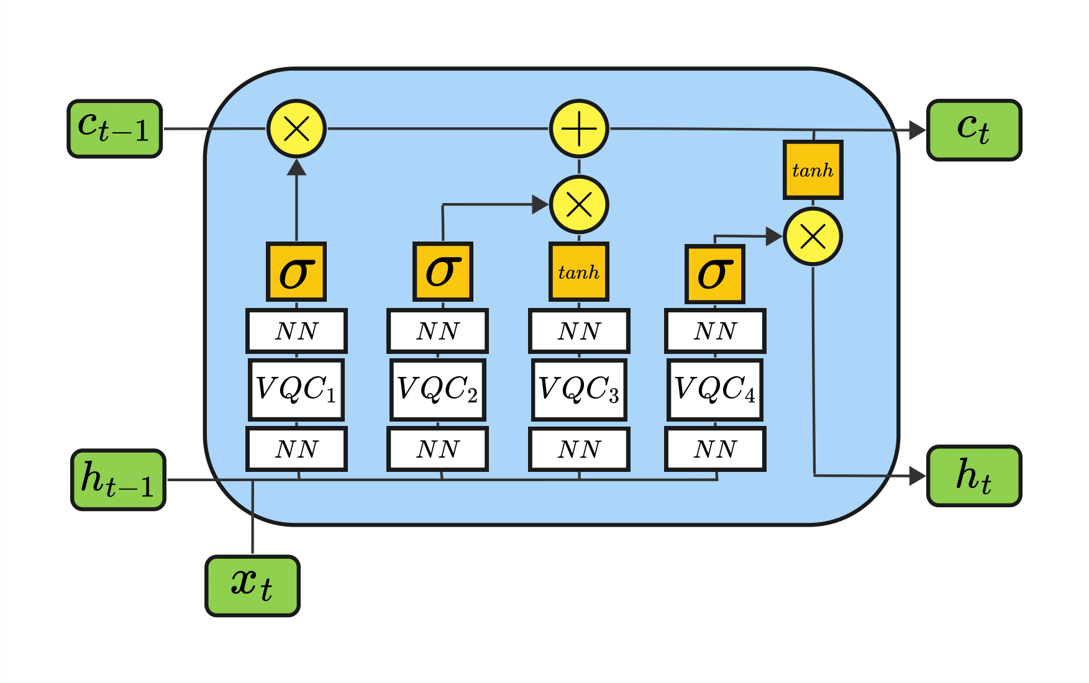
Experimental Setup: Training
Training Setup
For every seed 1..5:
For every episode 1..50:
MSE
Loss Function
Adam
Optimizer [6]
Reproducibility:
50 Epochs, 5 Seeds
For every stock 1..30:
Train the QLSTM on the train dataset
Training Improvements
Perform Early Stopping
Use Linear Decay LR Scheduler [7]
Quantum Machine Learning for Stock Market Prediction

Slide 15


Experimental Setup: Testing
Testing Setup
Metrics:
Calculating Accuracy
Price
Direction
1
10
Long/Short
Prediction:
Day Prediction
Days Prediction
Hardware:
Training
70%
Testing
30%
PennyLane Simulator [8]
IBM Quantum [9]
Quantum Machine Learning for Stock Market Prediction

Slide 16
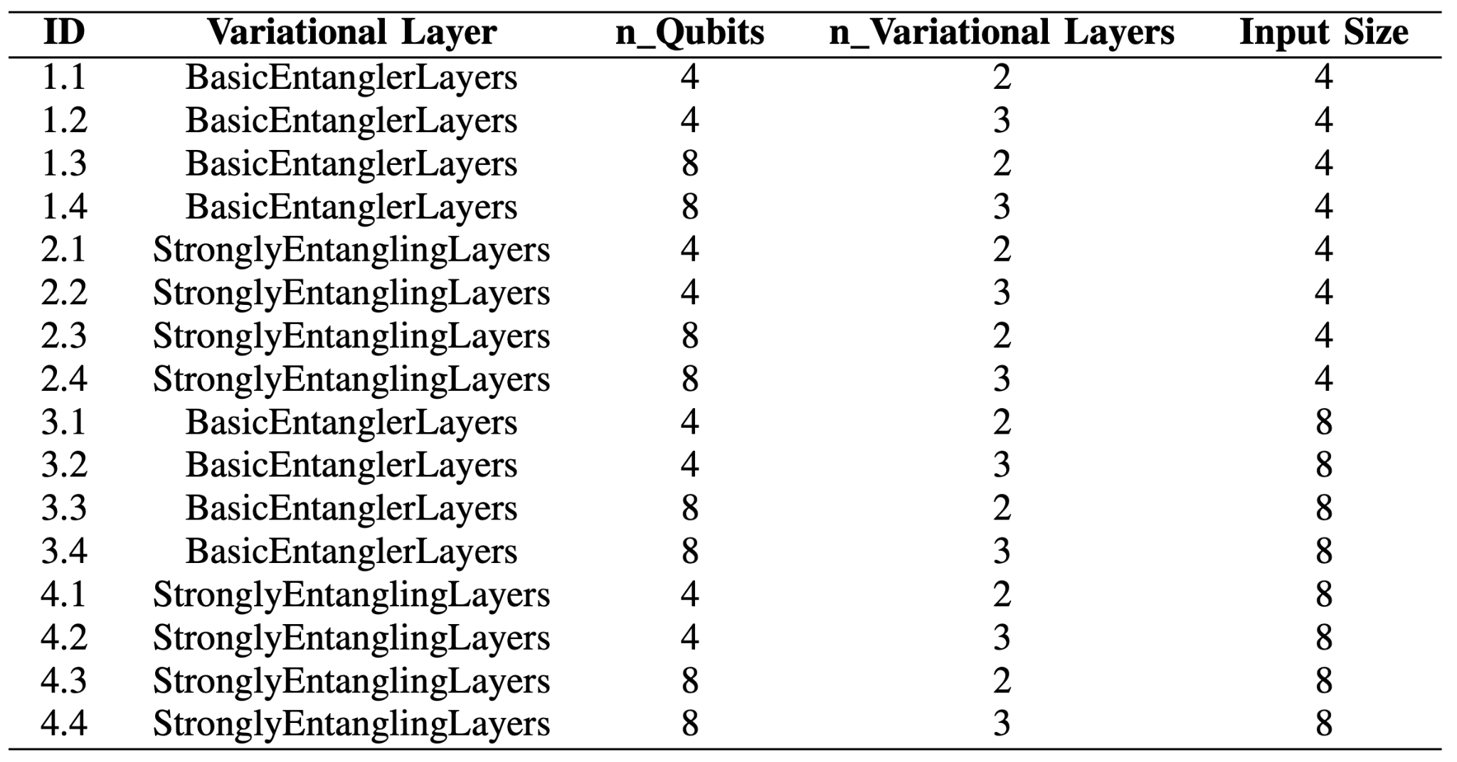
QLSTM Architectures
Different VQC architectures
Lookback with 5, 10, and 20
Quantum Machine Learning for Stock Market Prediction

Slide 17
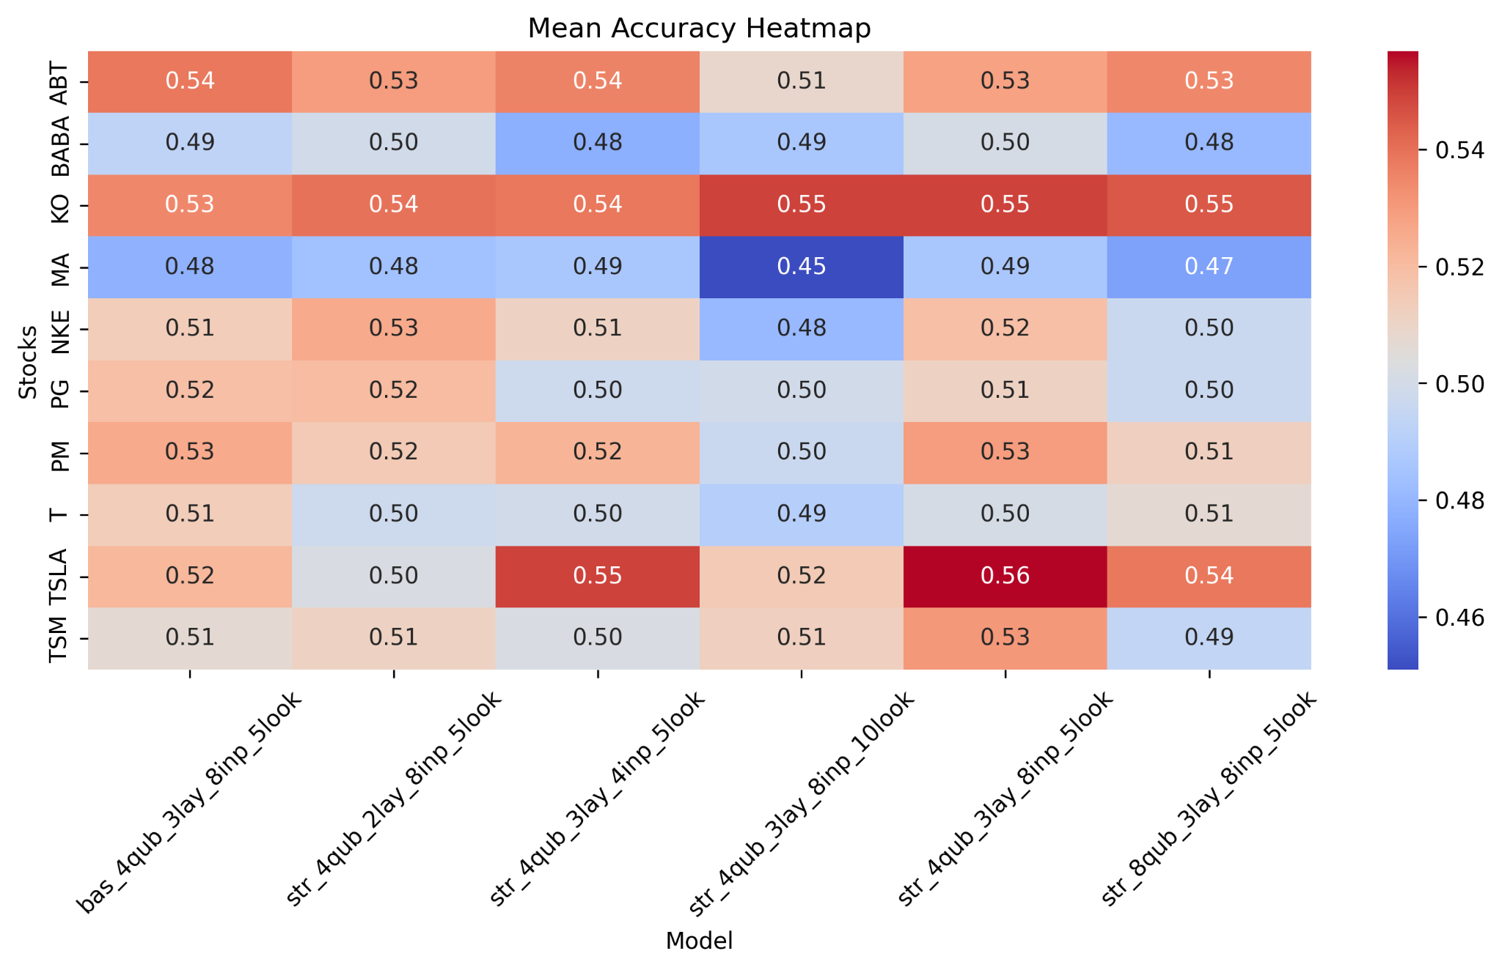
Results - Trend Accuracy Score
Quantum Machine Learning for Stock Market Prediction
Notes:
names, heatmap take lstm into consideration

Slide 18
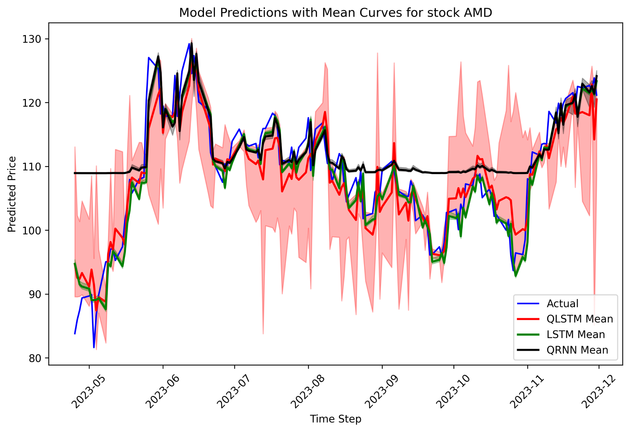
Results - 1 Day Prediction - AMD
Quantum Machine Learning for Stock Market Prediction
Notes:
qrnn bad performance due to missing gradient calculation over long time

Slide 19
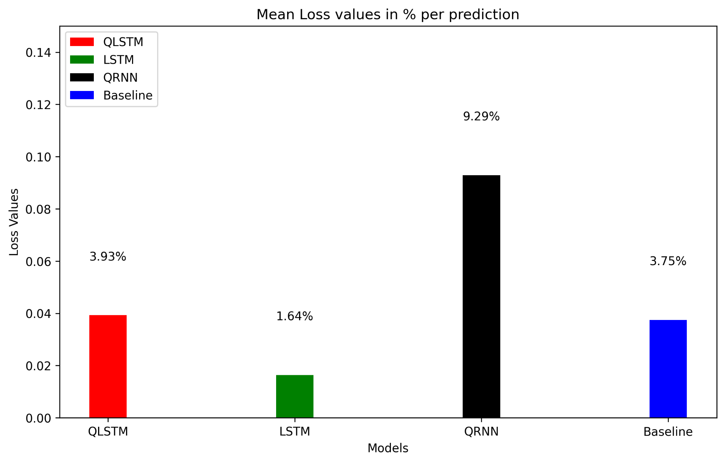
Results - 1 Day Prediction - Loss in %
Quantum Machine Learning for Stock Market Prediction

Slide 20
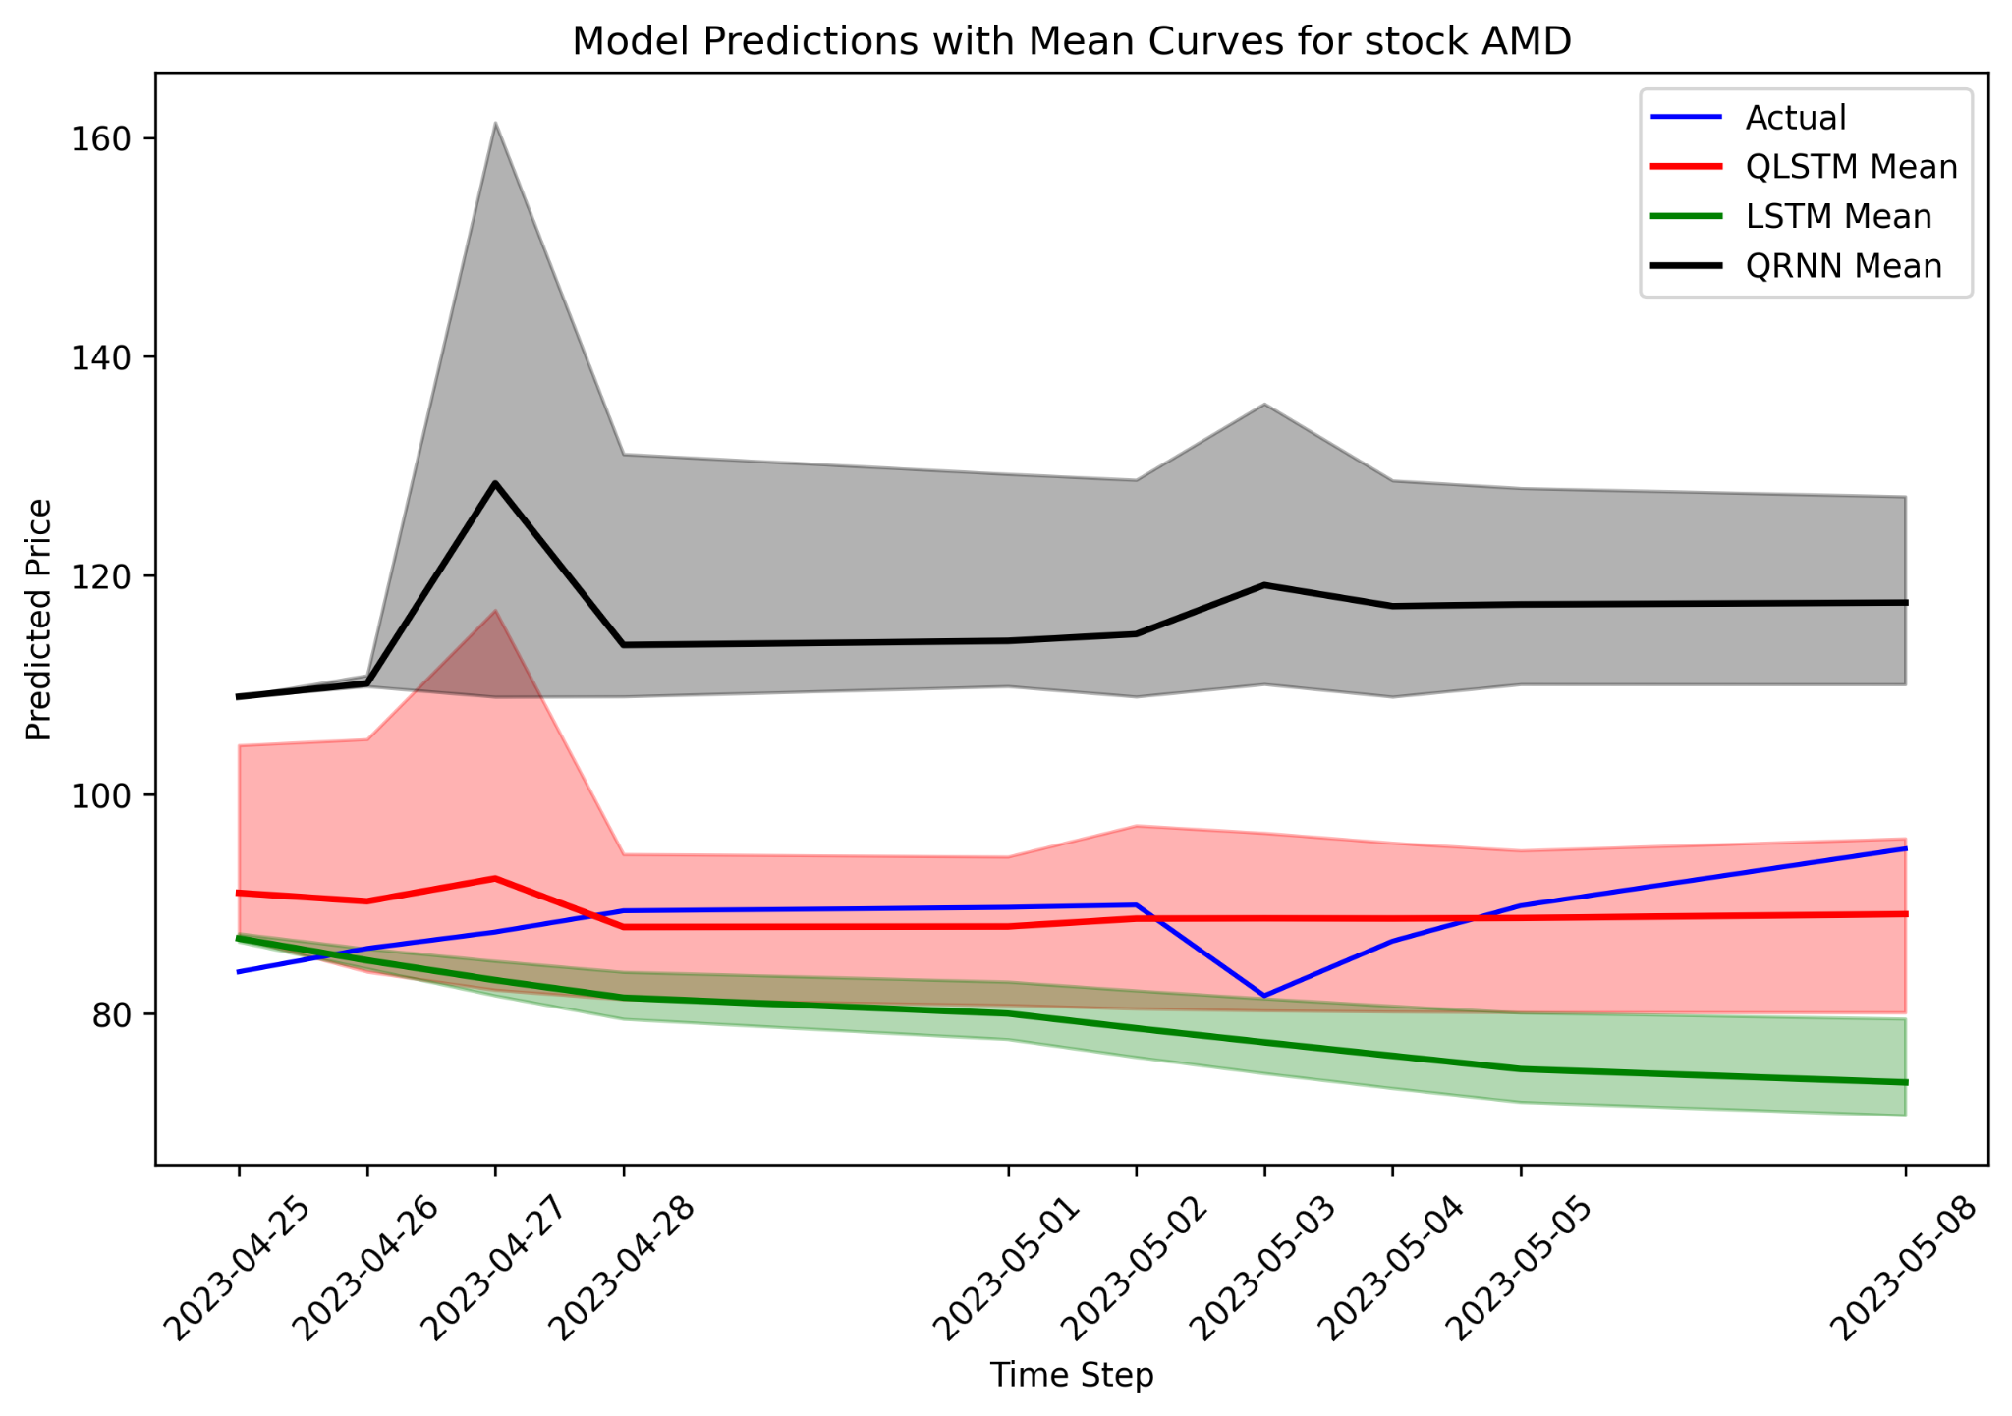
Results - 10 Day Prediction - AMD
Quantum Machine Learning for Stock Market Prediction

Slide 21
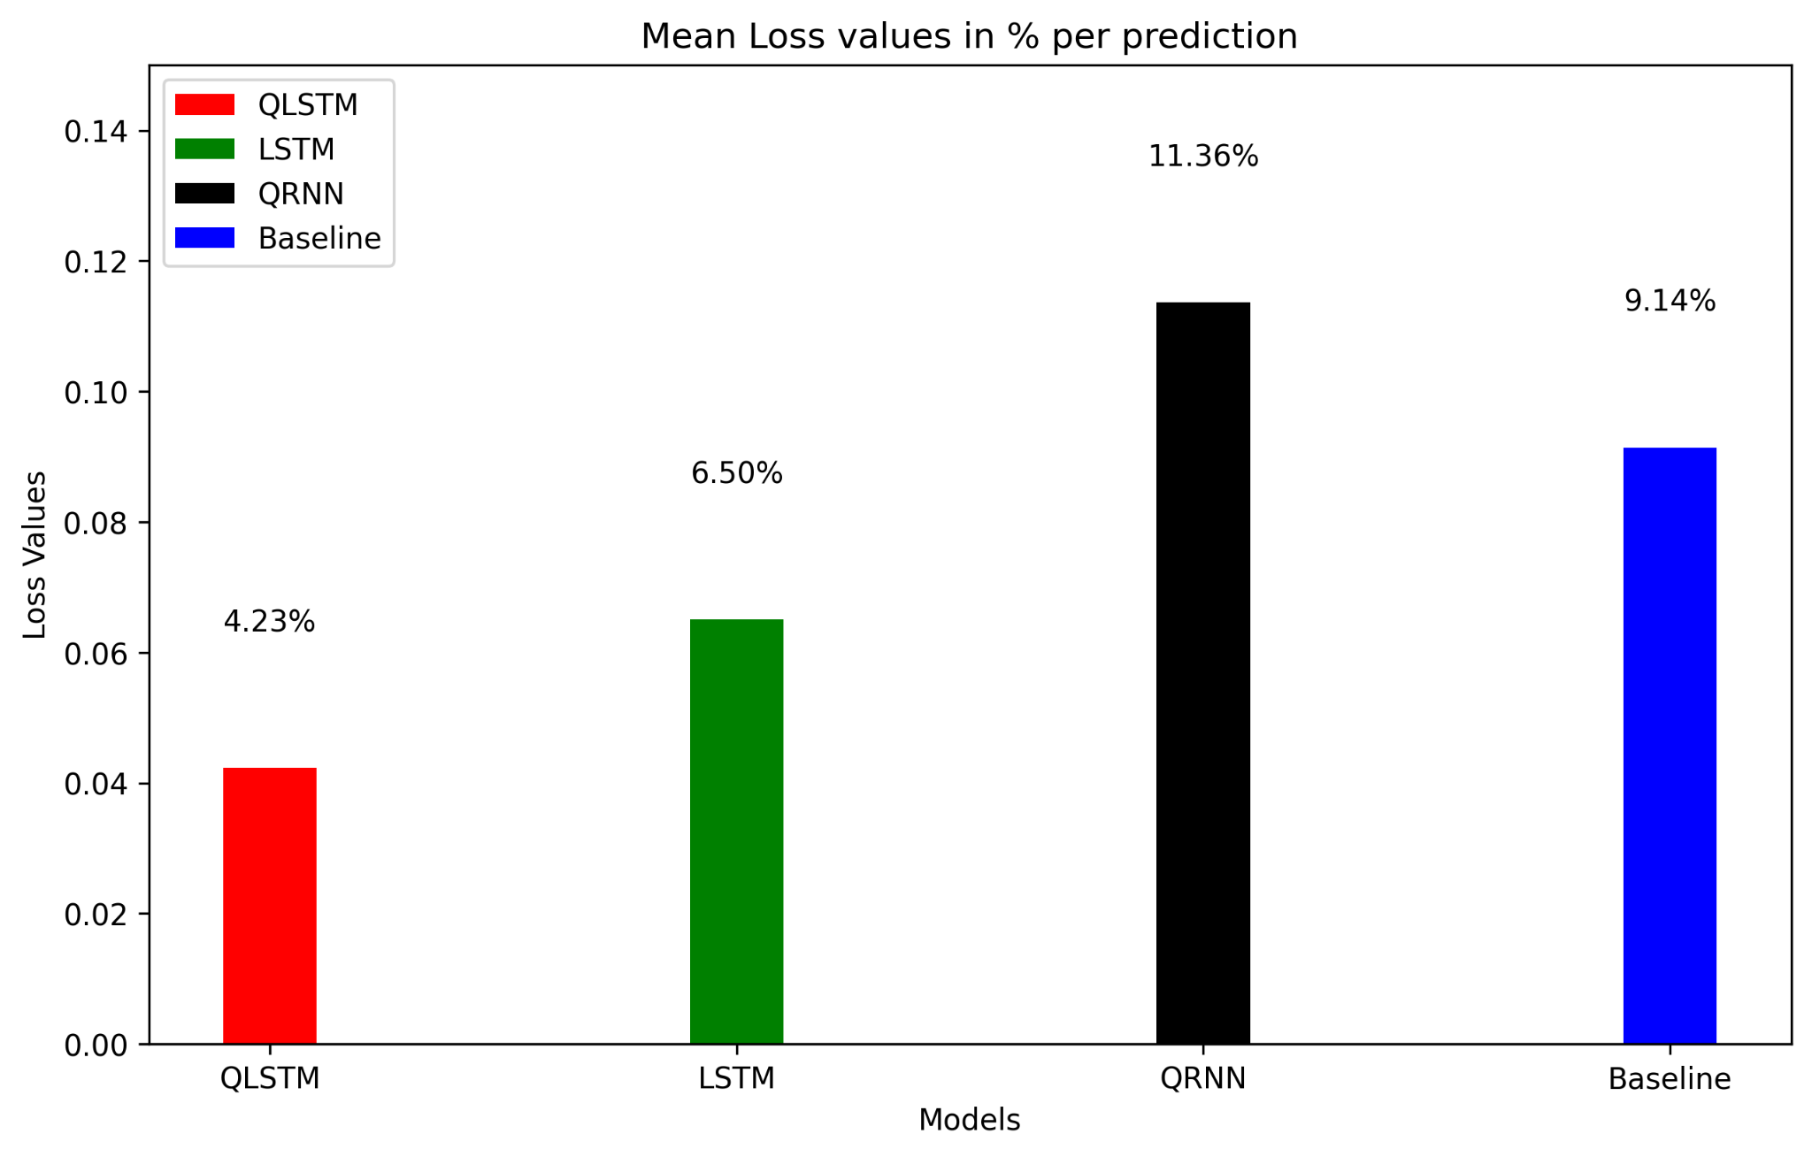
Results - 10 Day Prediction - Loss in %
Quantum Machine Learning for Stock Market Prediction
Notes:
add baseline loss, error bars with mean max min, prozentuale abweichung, rmse

Slide 22
Conclusion and Future Work
Conclusion
QLSTM has the potential for long-term predictions.
Involving real-time data could create a viable day trading application.
Optimizing VQC architectures and tuning hyperparameters are key for QLSTM performance.
Obstacles
Software: optimizing a QLSTM model to predict stock prices is difficult.
Hardware: IBM-Q long queue.
Future Work
Simulated trading as a performance metric.
Include sentiment data as input and more focus on input engineering.
Other parameters and training strategies could yield even better results.
Quantum Machine Learning for Stock Market Prediction

Slide 23
Thank You!
Quantum Machine Learning for Stock Market Prediction

Slide 24
Resources
[1] Alpha Vantage API, https://www.alphavantage.co/
[2] 2020, Samuel Yen-Chi Chen, Shinjae Yoo, and Yao-Lung L. Fang.
[3] Quantum recurrent neural networks for sequential learning, 2023, Yanan Li, Zhimin Wang, Rongbing Han, Shangshang Shi, Jiaxin Li, Ruimin Shang, Haiyong Zheng, Guoqiang Zhong, and Yongjian Gu.
[4] Quantum machine learning in finance: Time series forecasting, 2022, Dimitrios Emmanoulopoulos and Sofija Dimoska.
[5] The potential of quantum techniques for stock price prediction, 2023, Naman S, Gaurang B, Neel S, and Aswath Babu H.
[6] Diederik P. Kingma and Jimmy Ba. Adam: A method for stochastic optimization, 2017.
[7] Adam Paszke, et.al.Pytorch: An imperative style, high-performance deep learning library, 2019.
[8] Ville Bergholm et.al. Pennylane: Automatic differentiation of hybrid quantum-classical computations, 2022.
[9] IBM. Quantum computing. https://research.ibm.com/ quantum-computing, 2023.
Quantum Machine Learning for Stock Market Prediction

Slide 25
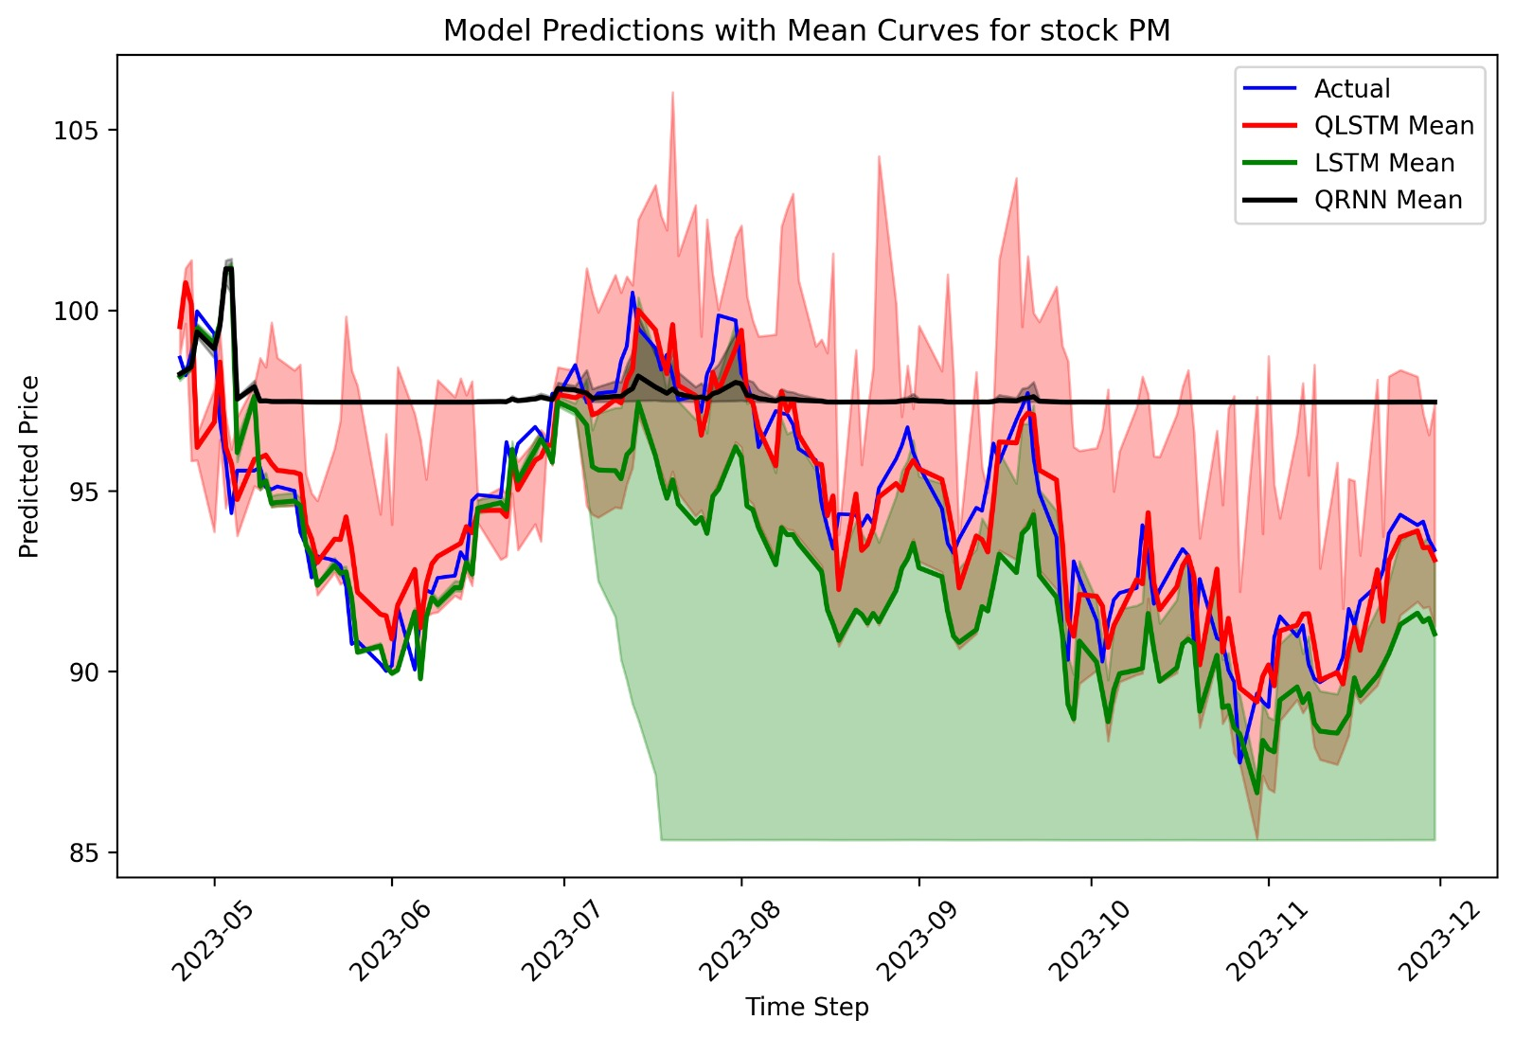
Backup – 1 Day Prediction PM
Quantum Machine Learning for Stock Market Prediction

Slide 26
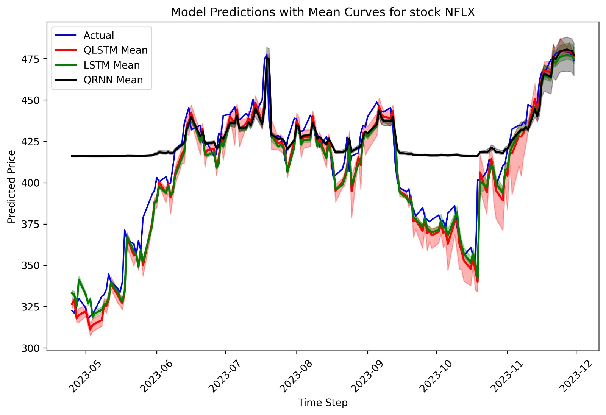
Backup – 1 Day Prediction NFLX
Quantum Machine Learning for Stock Market Prediction

Slide 27
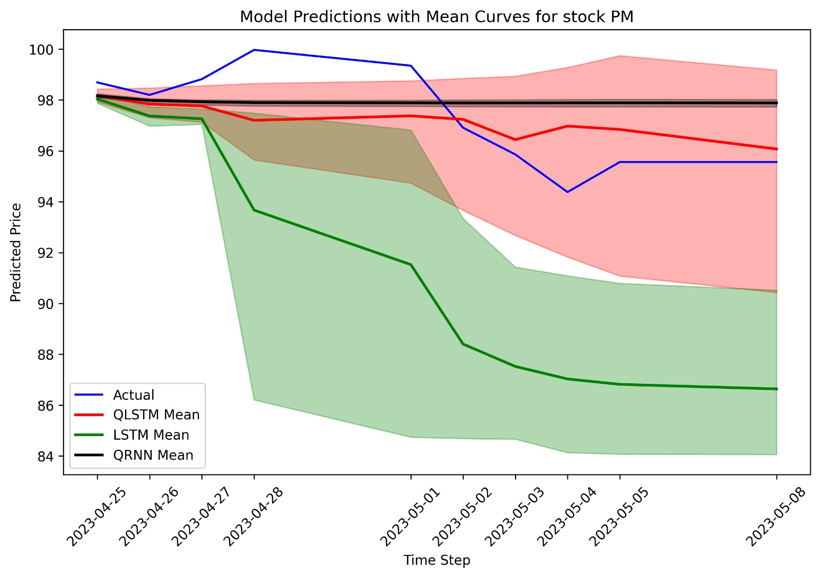
Backup – 10 Day Prediction PM
Quantum Machine Learning for Stock Market Prediction

Slide 28

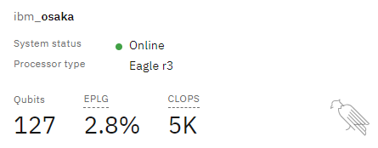
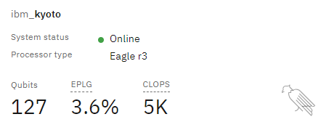
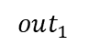
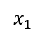
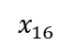
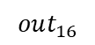
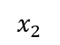
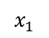
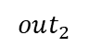
Backup – IBM-Q
Problem:
It’s not efficient to use 127-qubit hardware to execute 4-qubit circuits
$$x_{1}$$
$$out_{1}$$
Solution:
Concatenate circuits for a batch of data points and execute it on a 127-qubit system:
$$x_{1}$$
$$out_{1}$$
$$x_{2}$$
$$out_{2}$$
…
$$x_{16}$$
$$out_{16}$$
Quantum Machine Learning for Stock Market Prediction

